Slide 1
Sept 30th 2020 Open Comp
Wincanton Camera Club

Slide 2
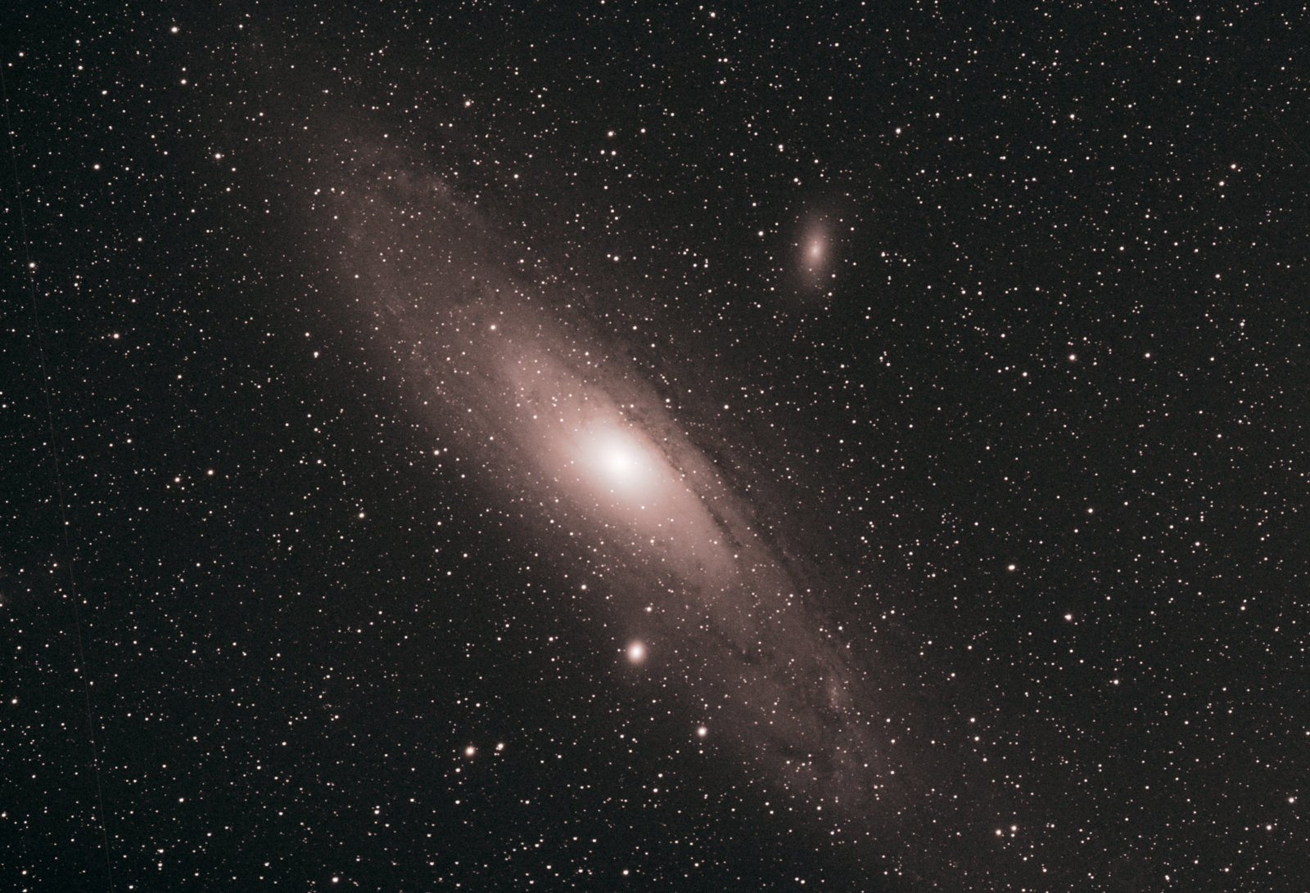
Andromeda_a galaxy far far away

Slide 3
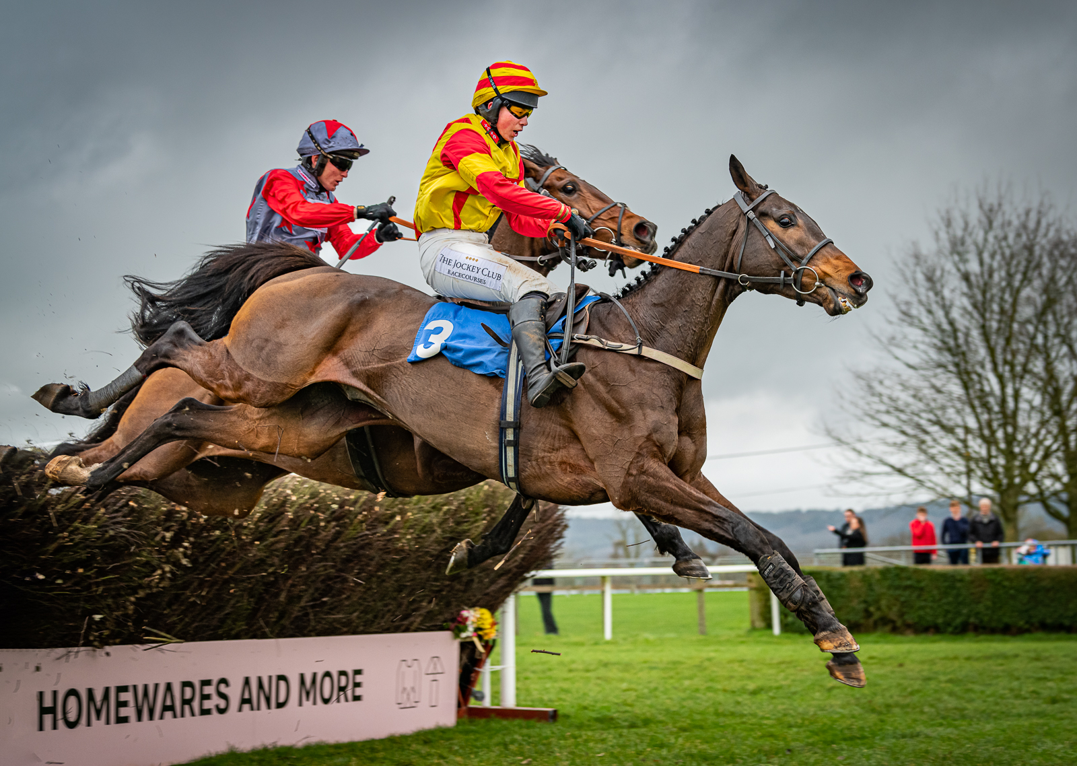
Beating_the_boys

Slide 4
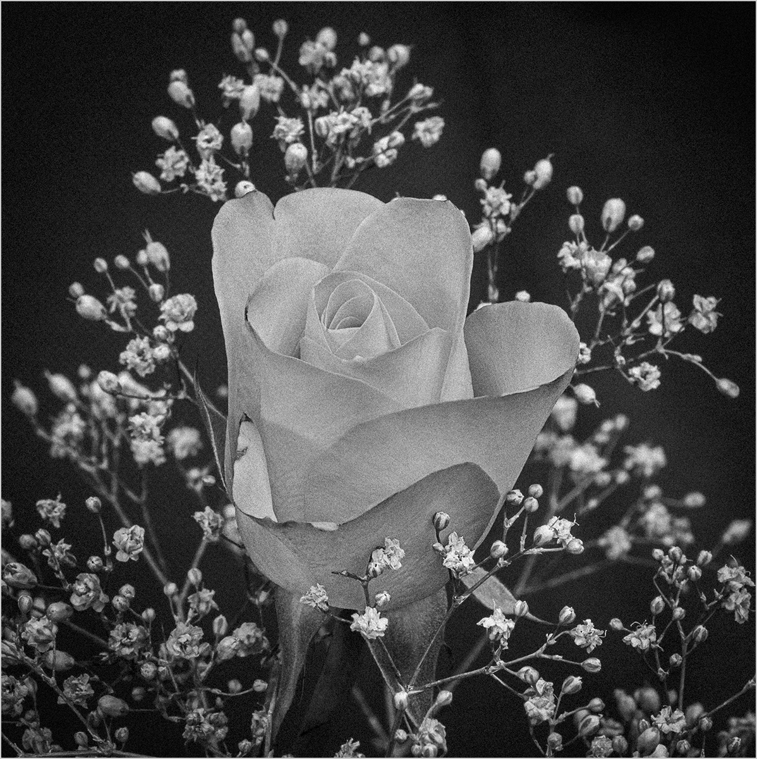
Black and white Rose

Slide 5
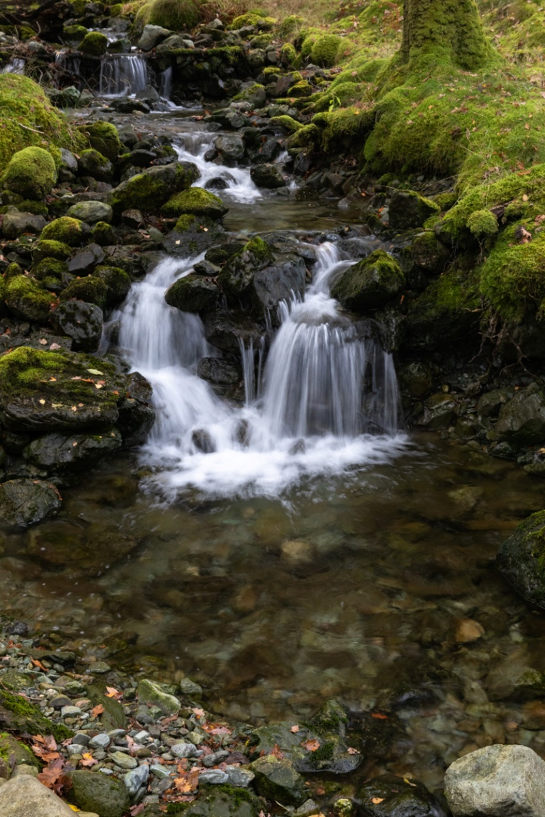
Borrowdale_stream

Slide 6
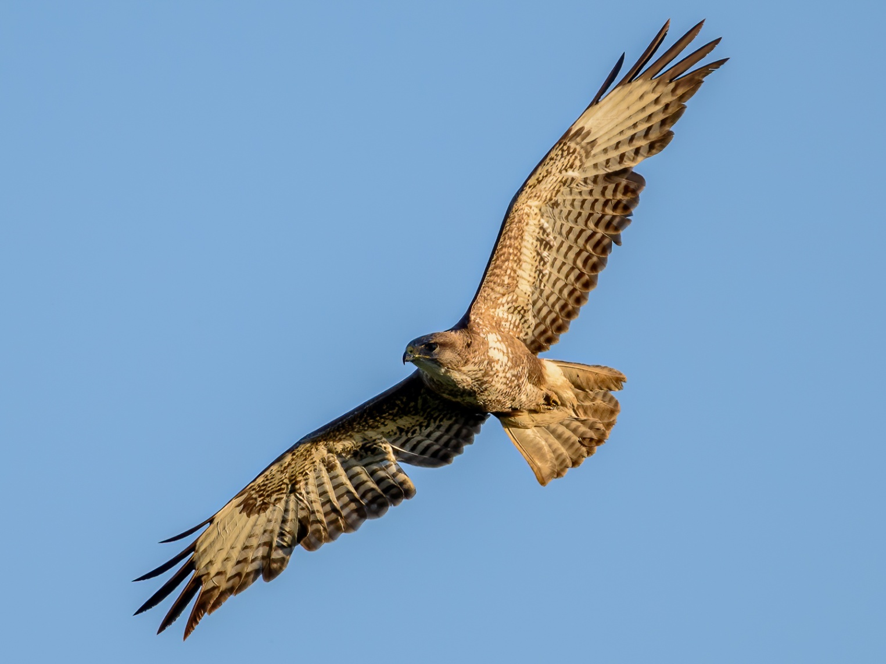
Buzzard in the golden light

Slide 7
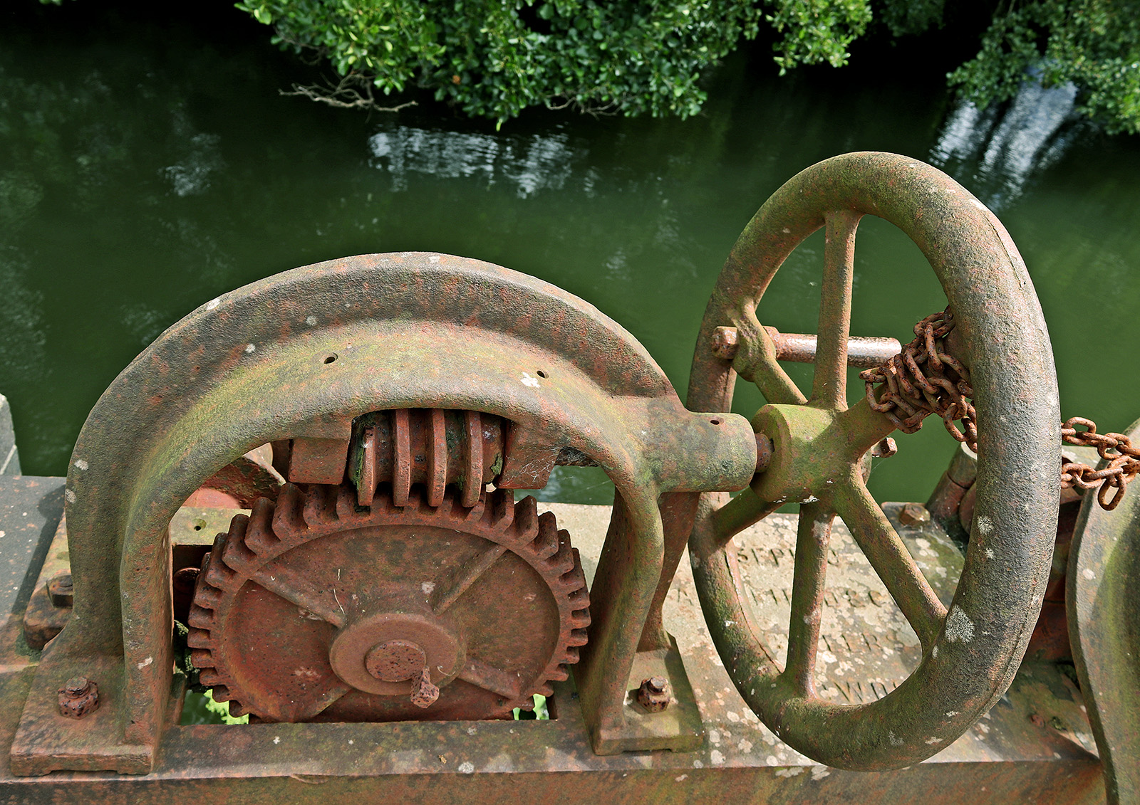
Disused Sluice Control

Slide 8
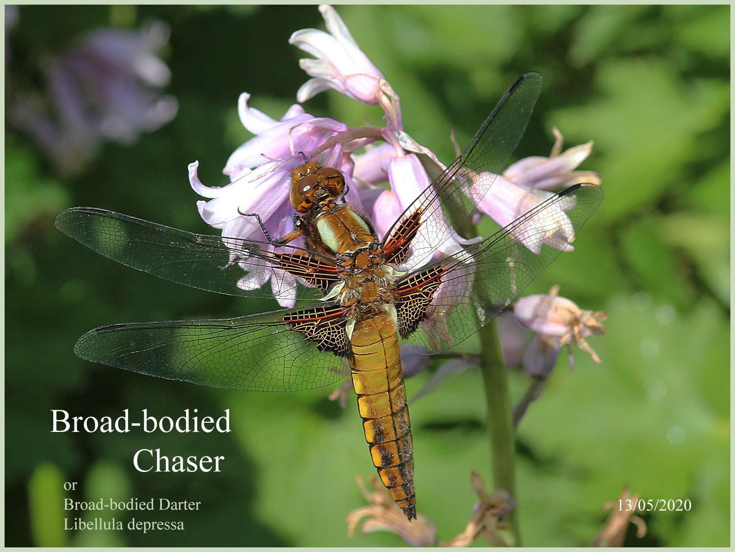
Dragonfly

Slide 9
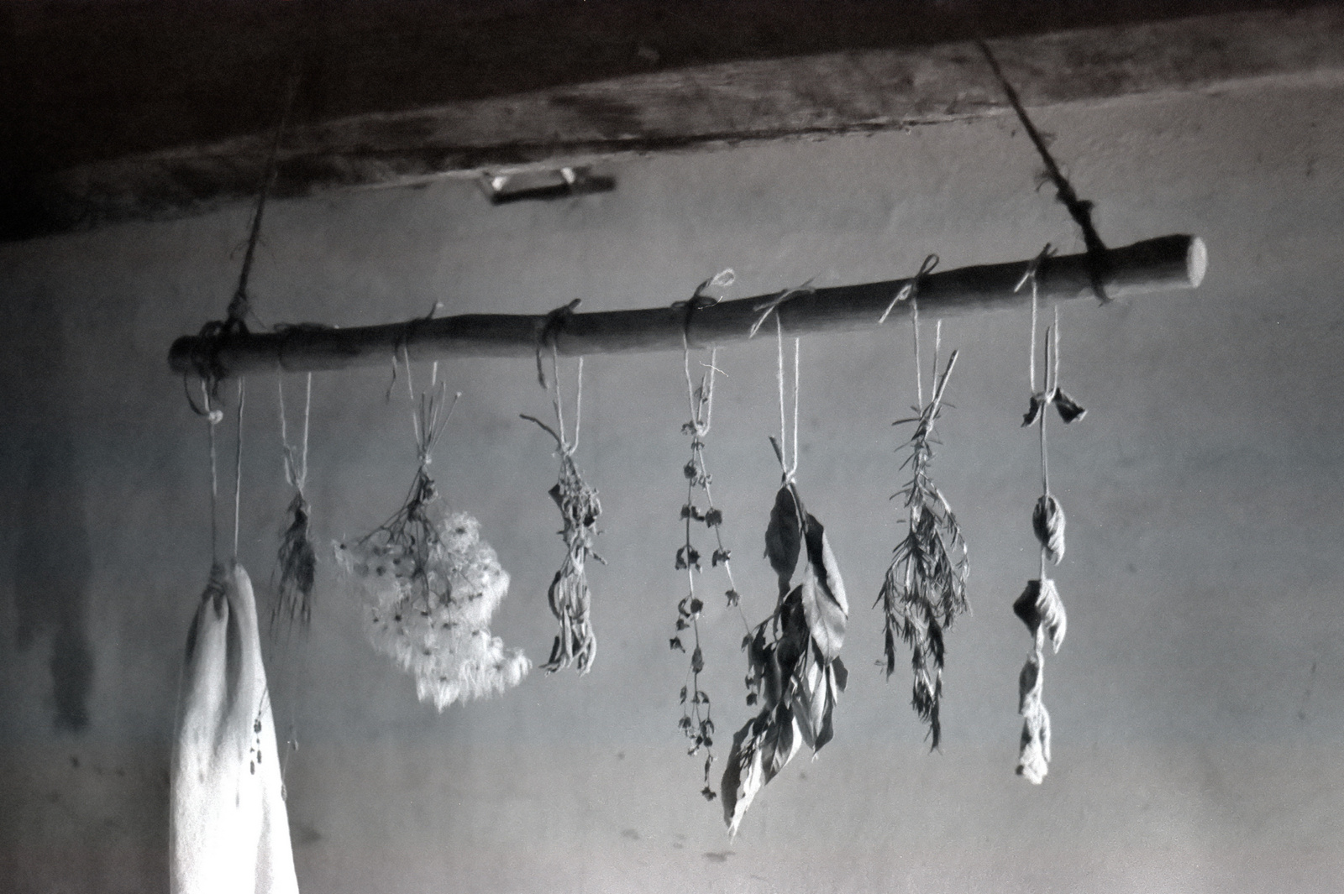
Drying Herbs

Slide 10
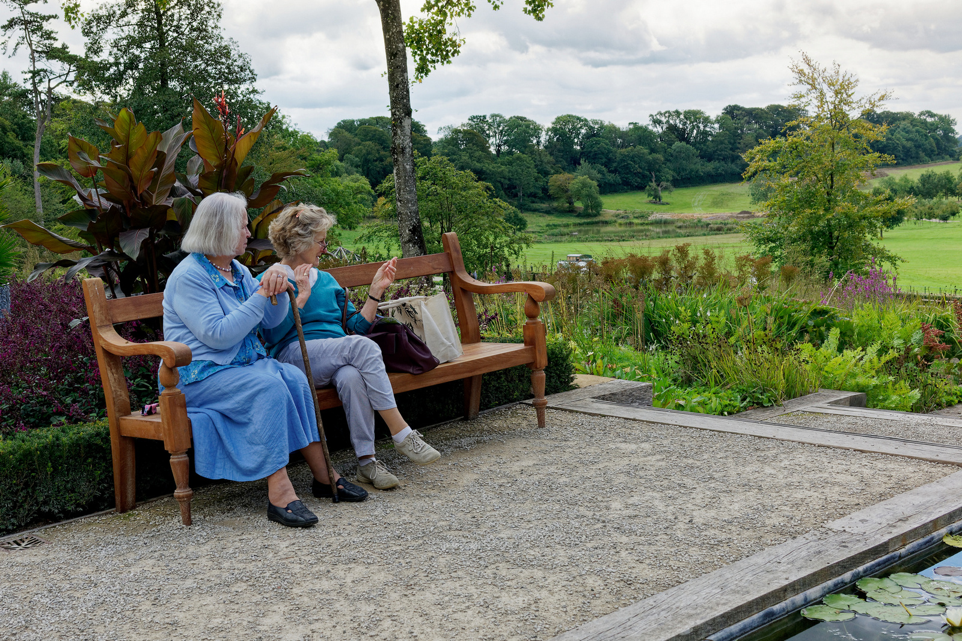
Enjoying the View

Slide 11
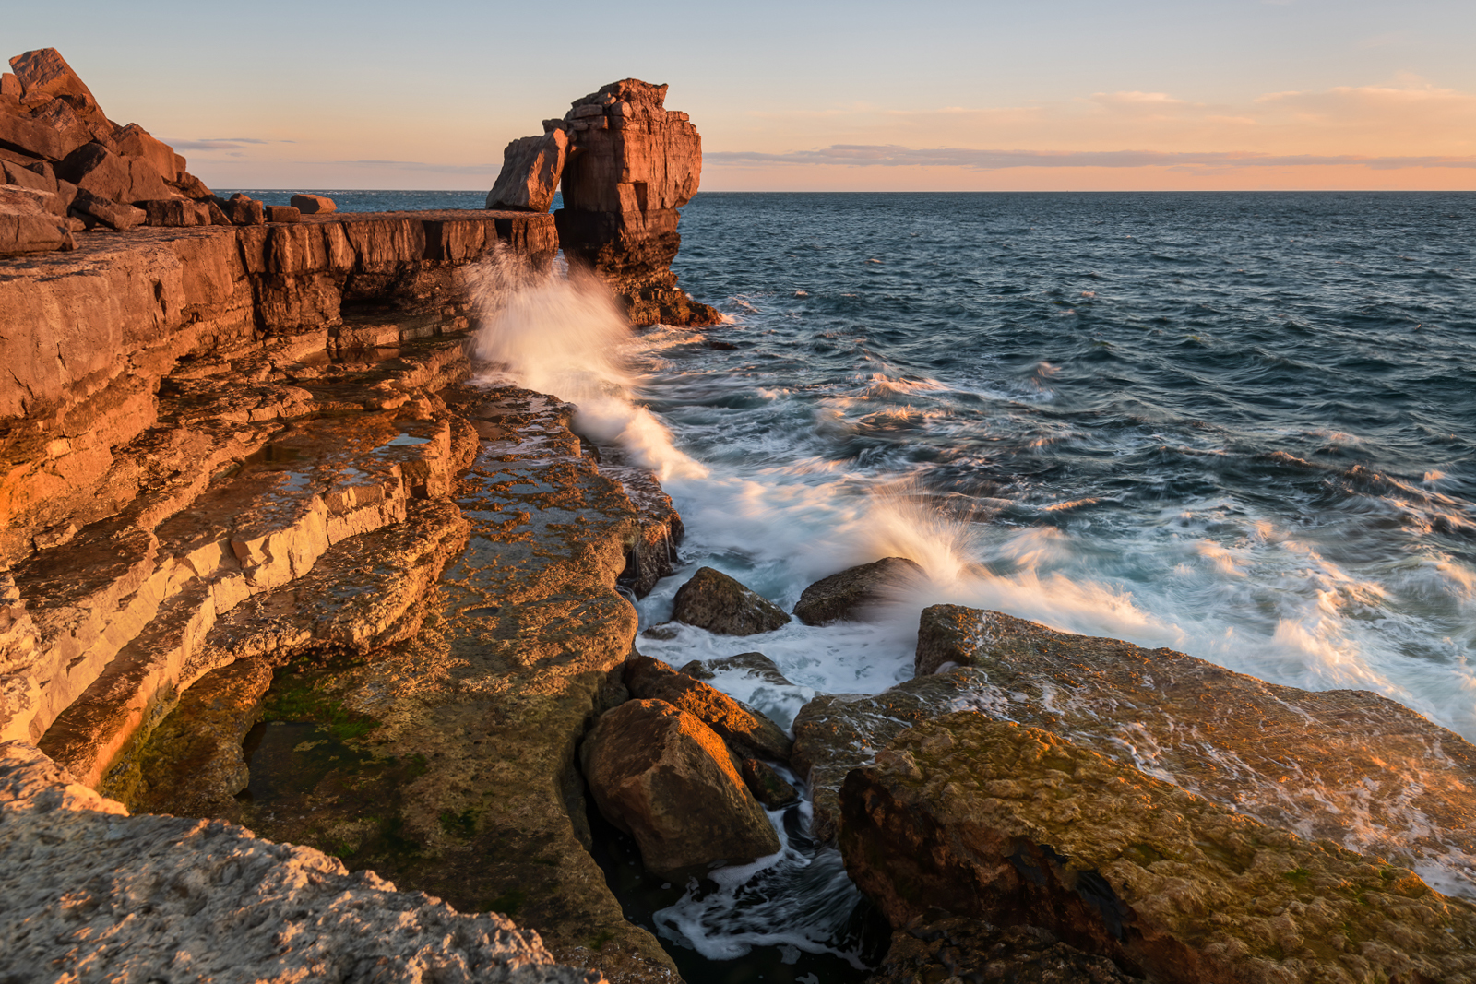
Evening glow at Pulpit Rock, Portland Bill

Slide 12
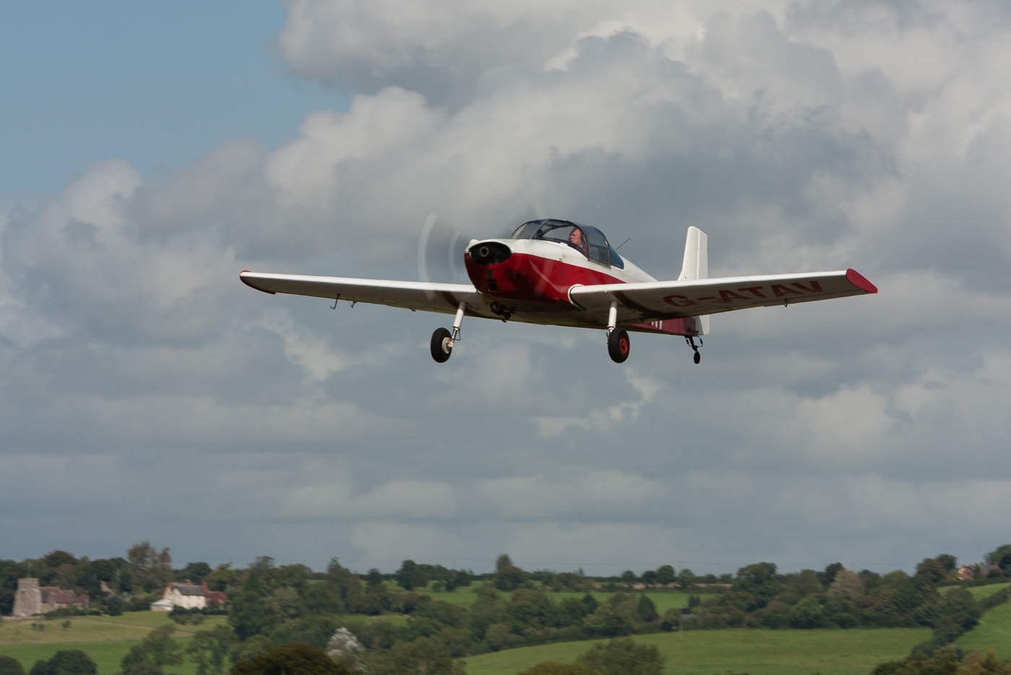
Final_approach

Slide 13
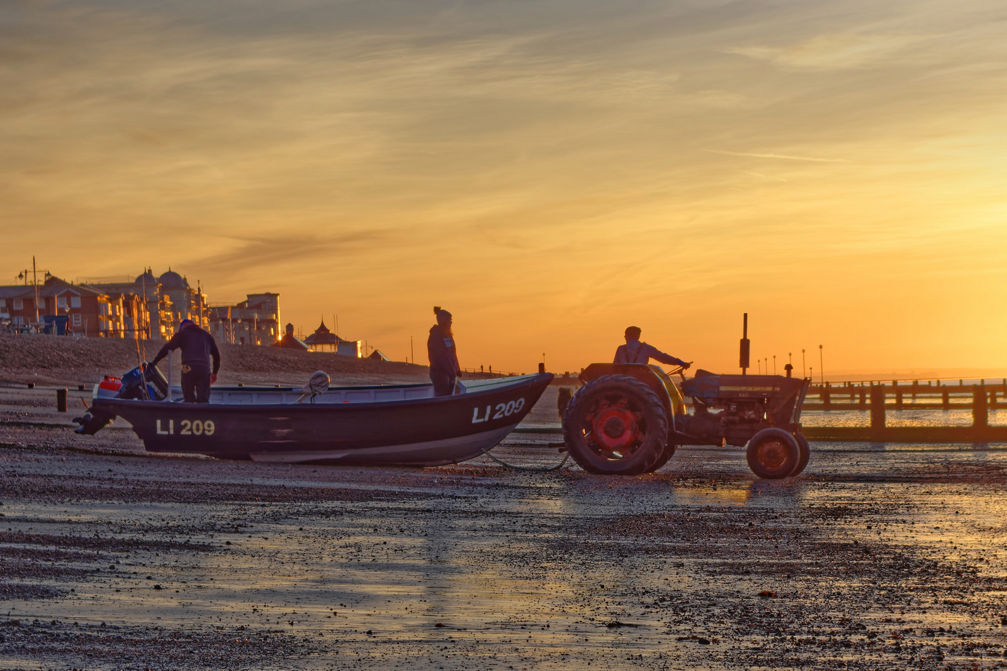
Going out to check the Pots

Slide 14
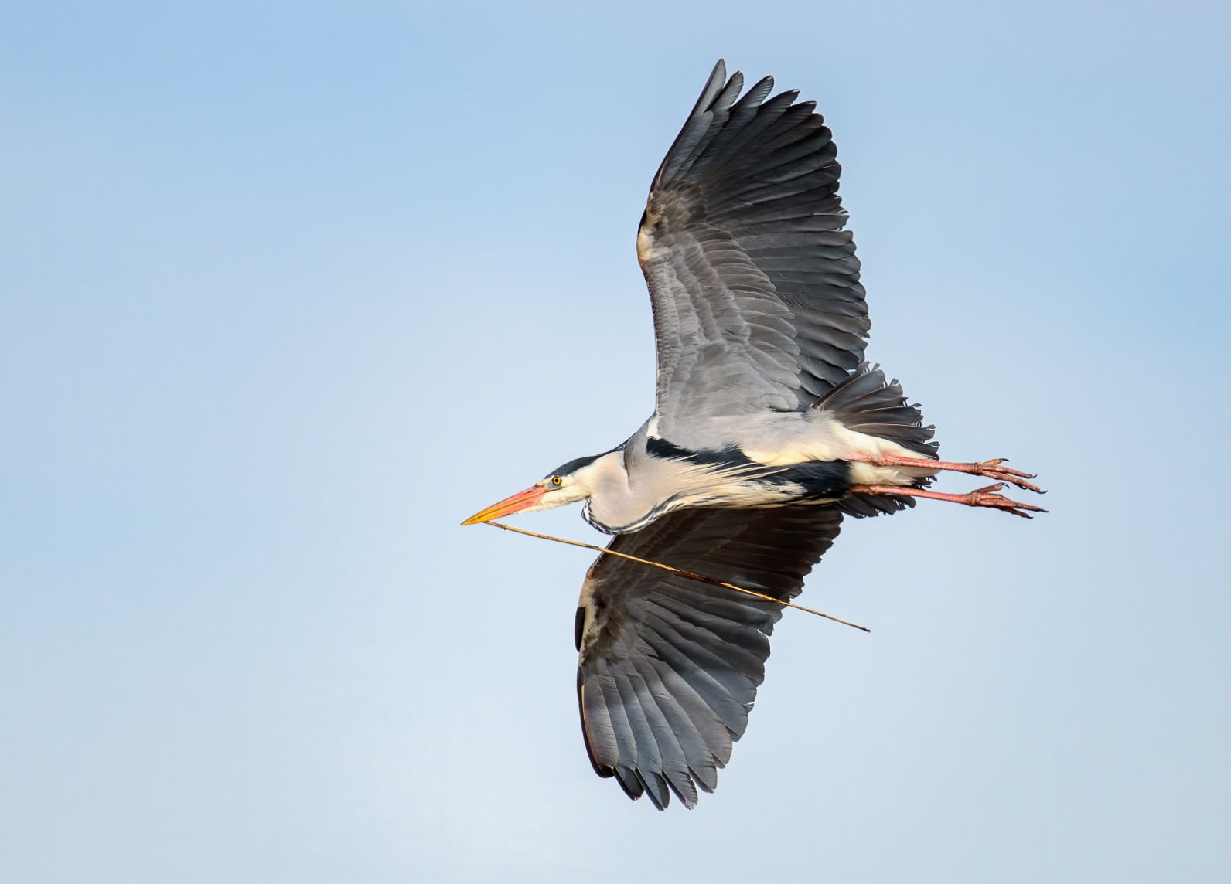
Grey Heron collecting nesting material

Slide 15
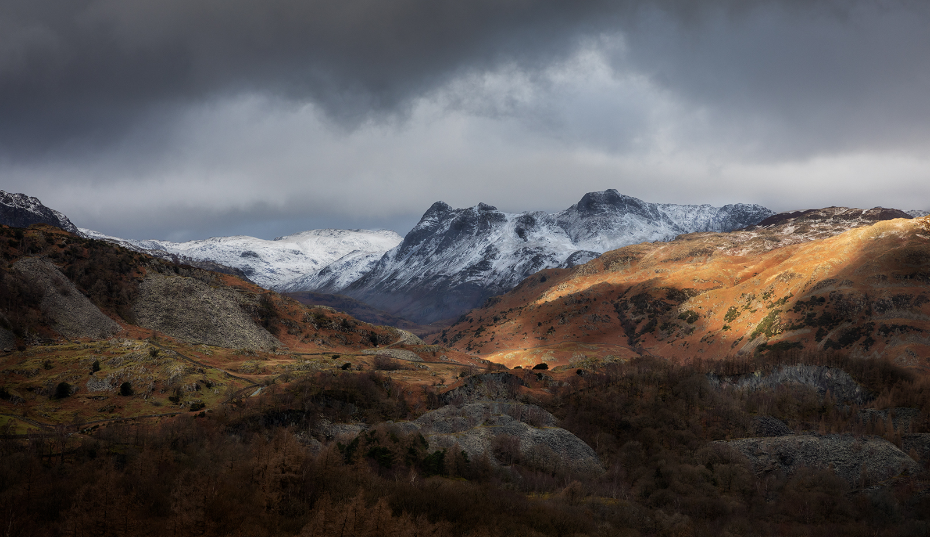
Hodge Close and the Langdales

Slide 16
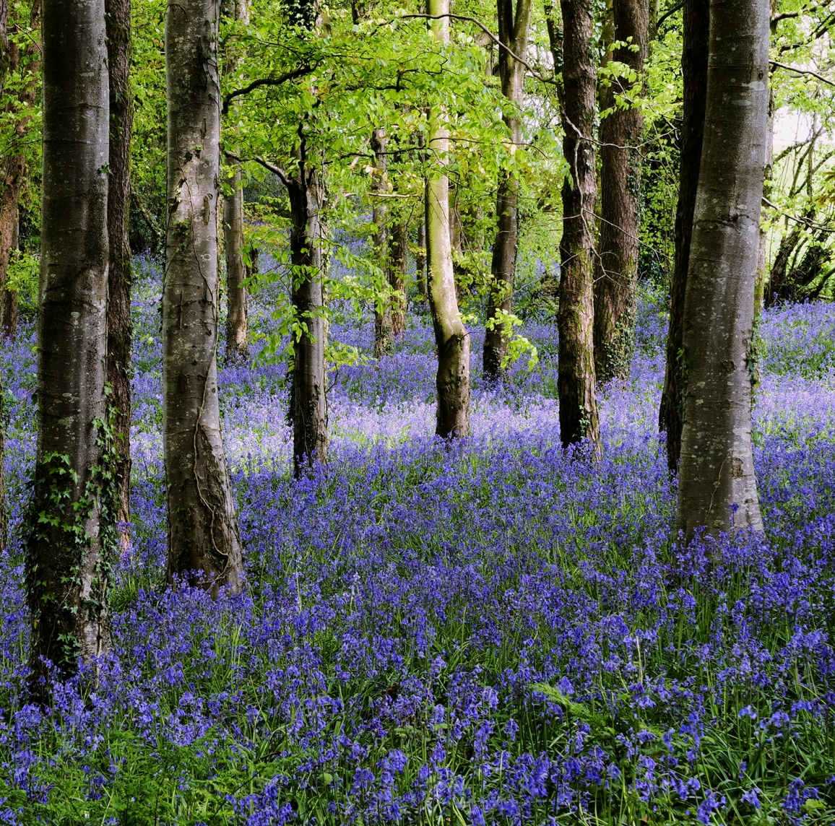
joys of spring

Slide 17
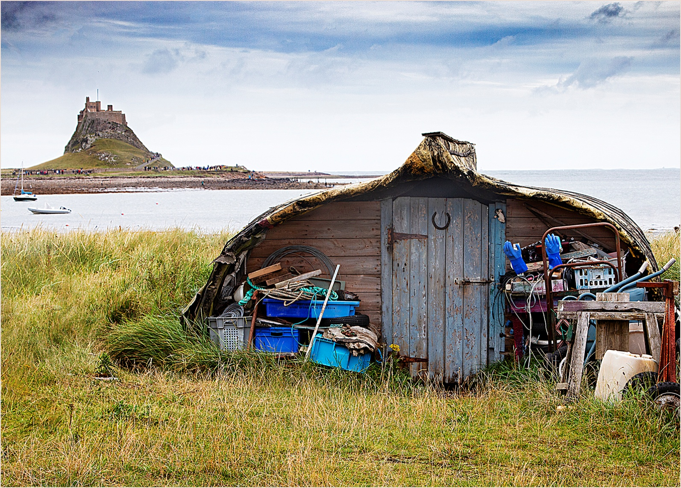
Lindisfarne Boat

Slide 18
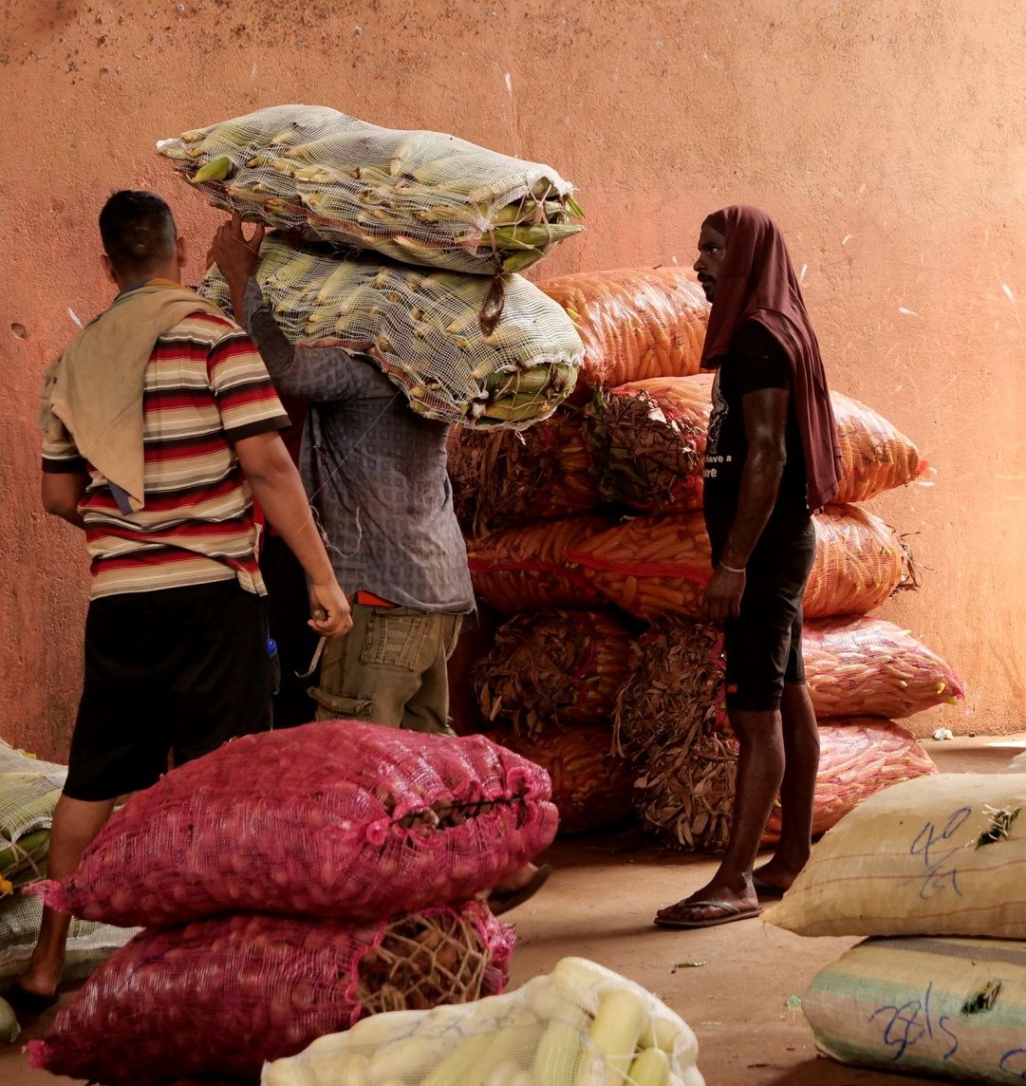
loading the corn

Slide 19
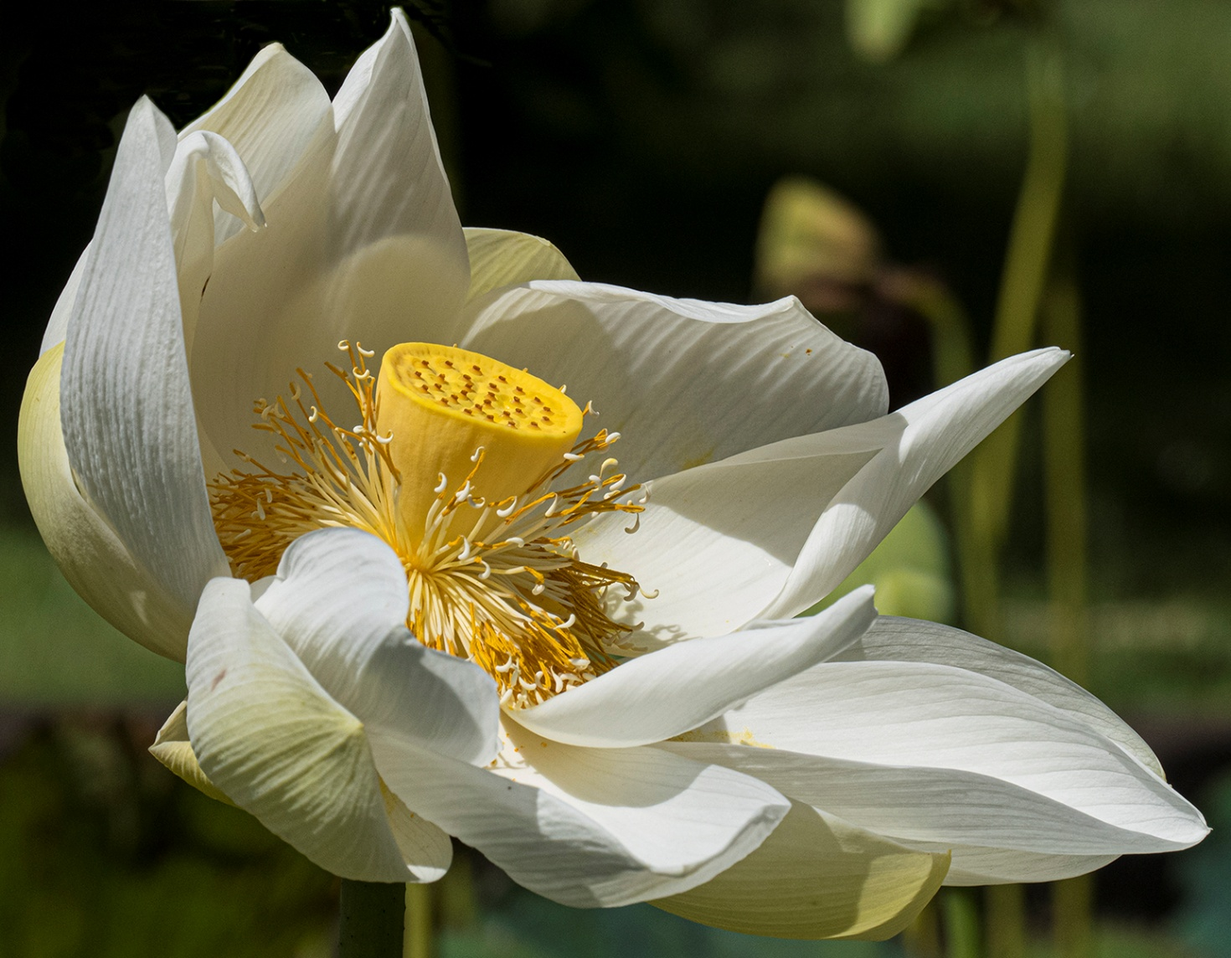
Lotus

Slide 20
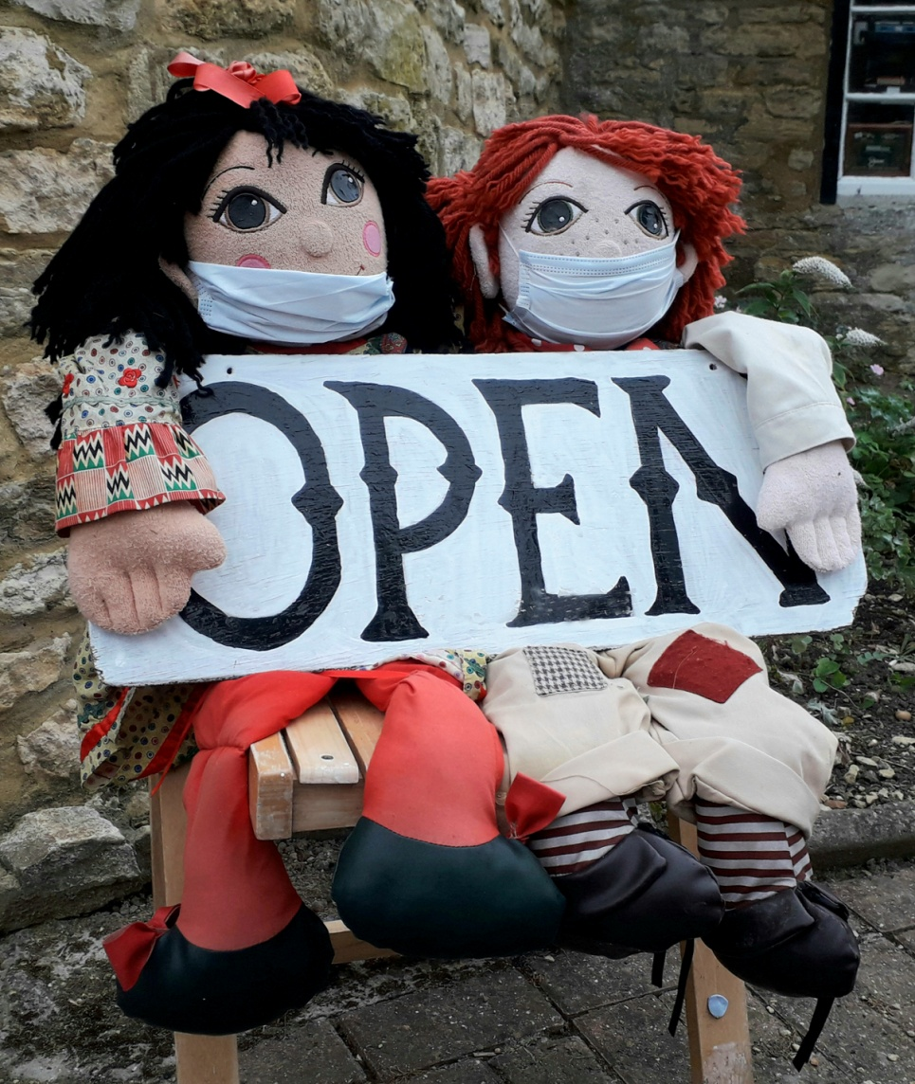
Open for Open

Slide 21
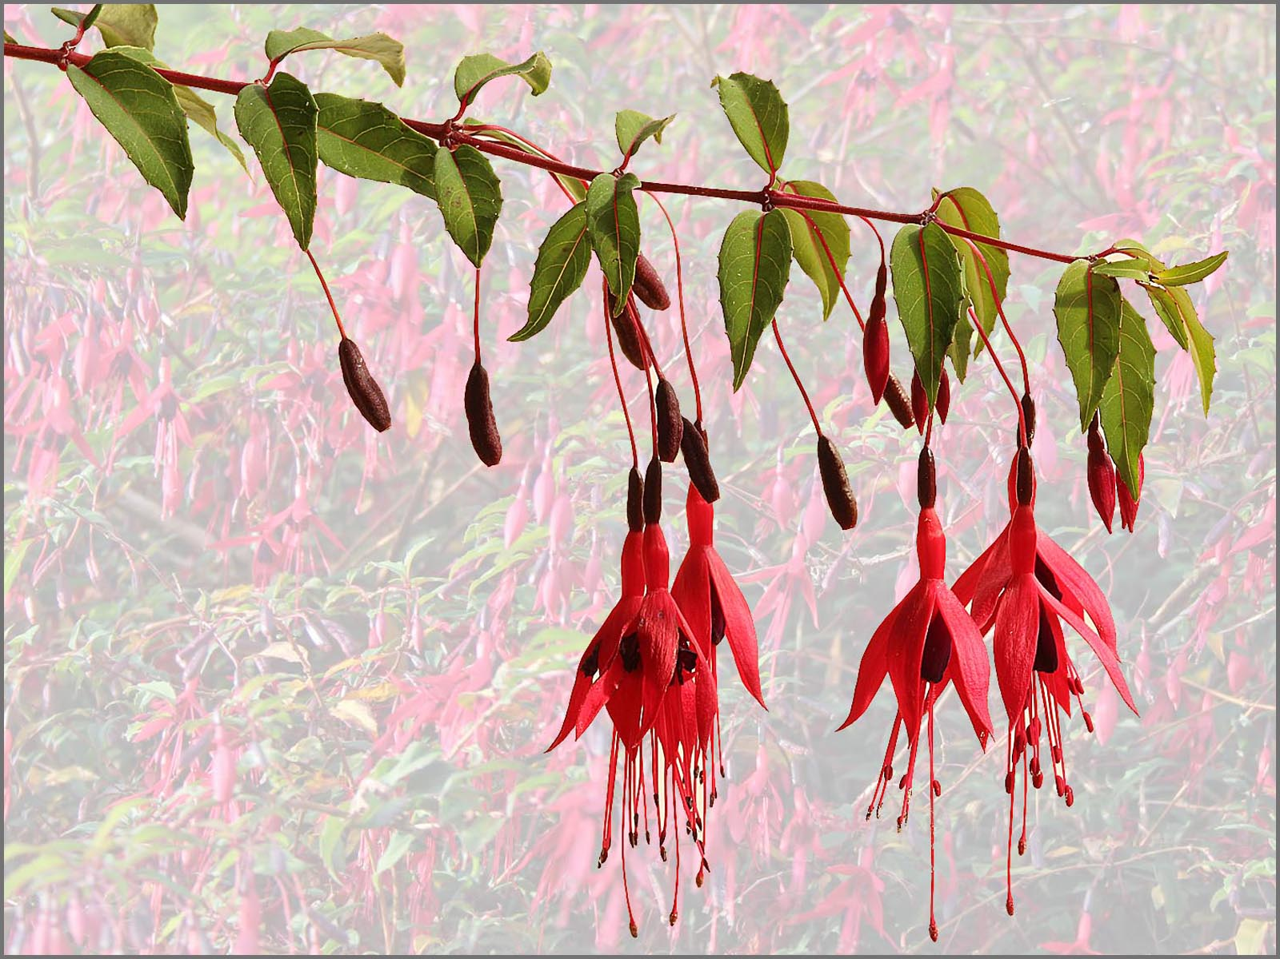
Riccartonii

Slide 22
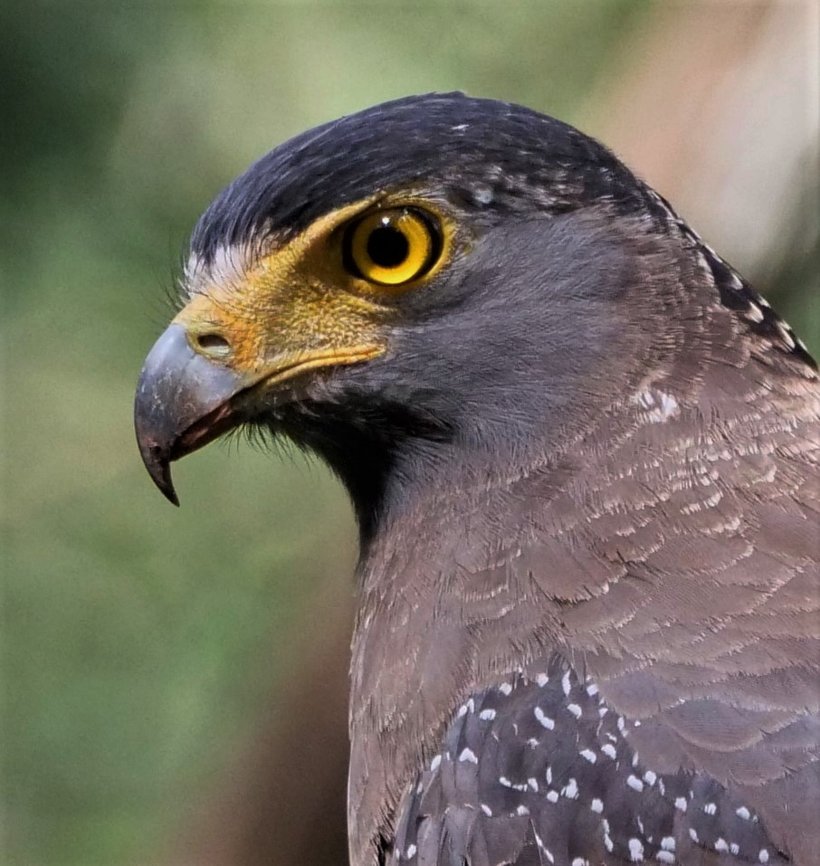
serpent eagle

Slide 23
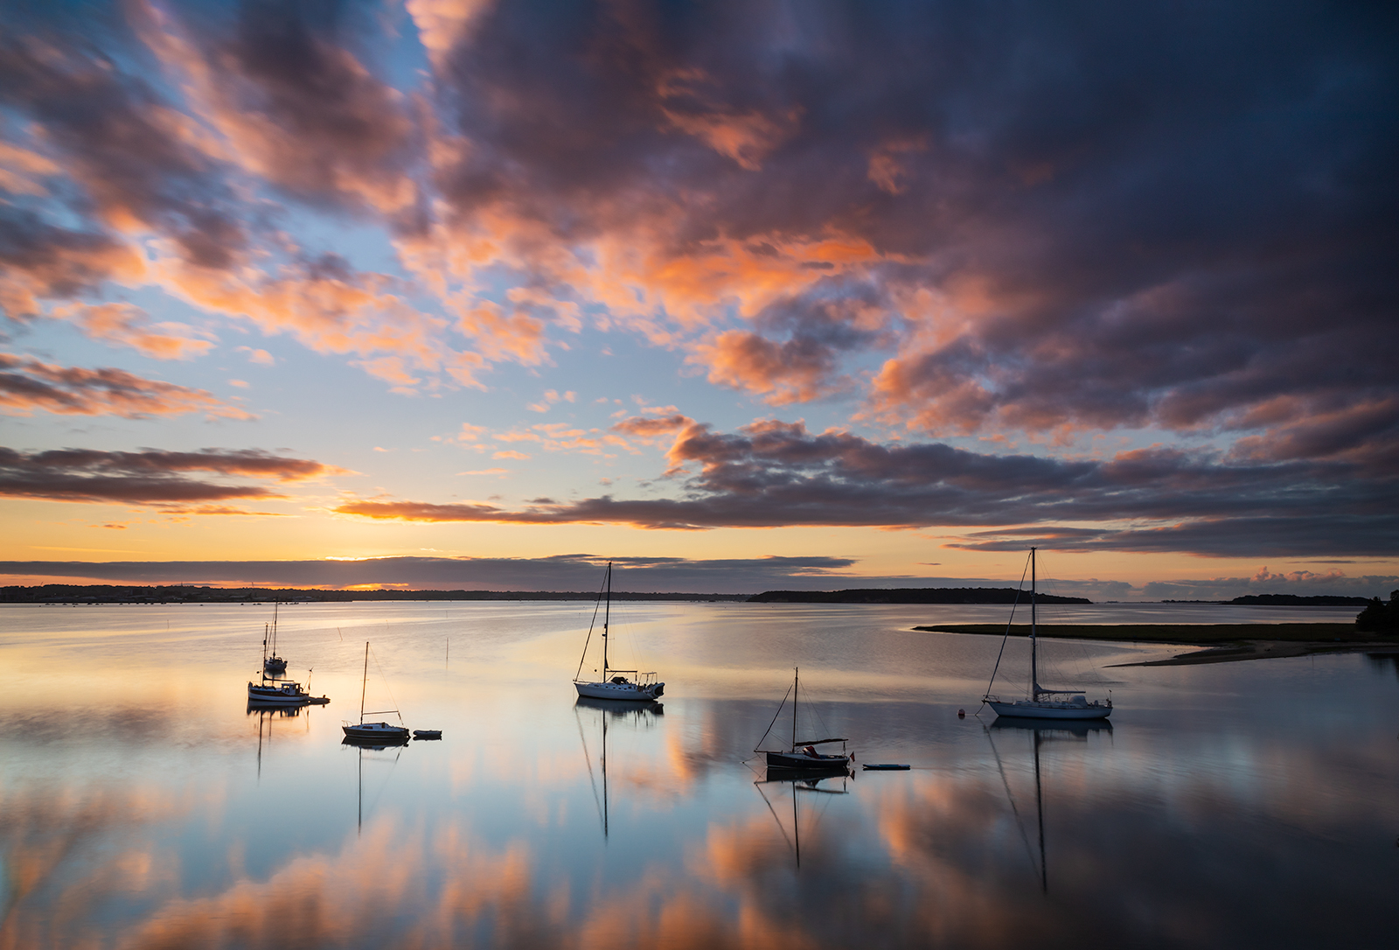
Shipstal Point

Slide 24
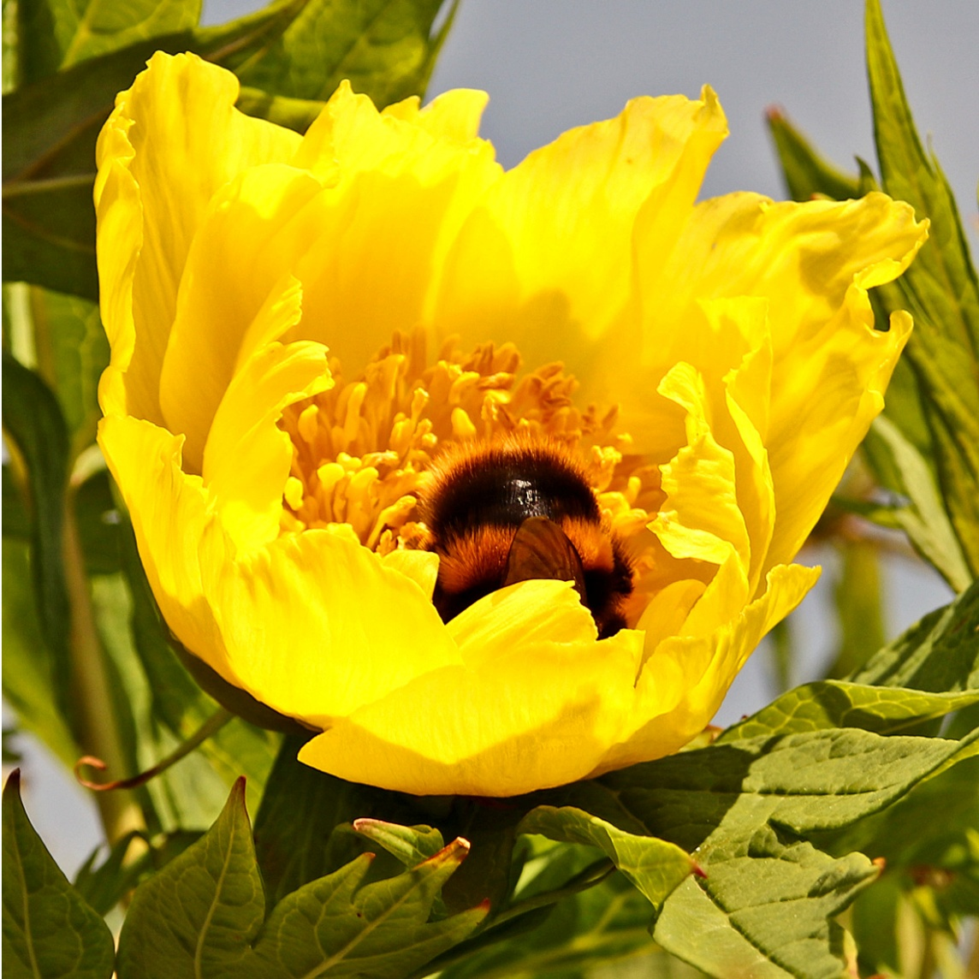
Sleeping Bumble Bee

Slide 25
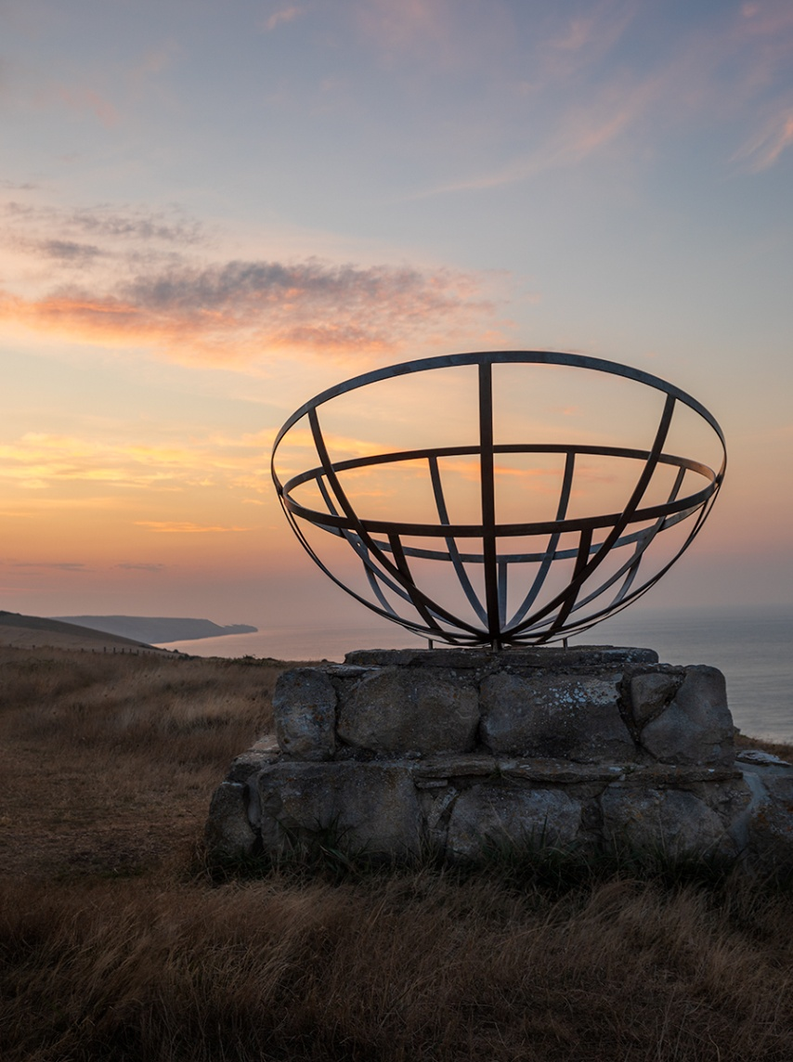
St Aldhelms. Radar- the unseen watch

Slide 26
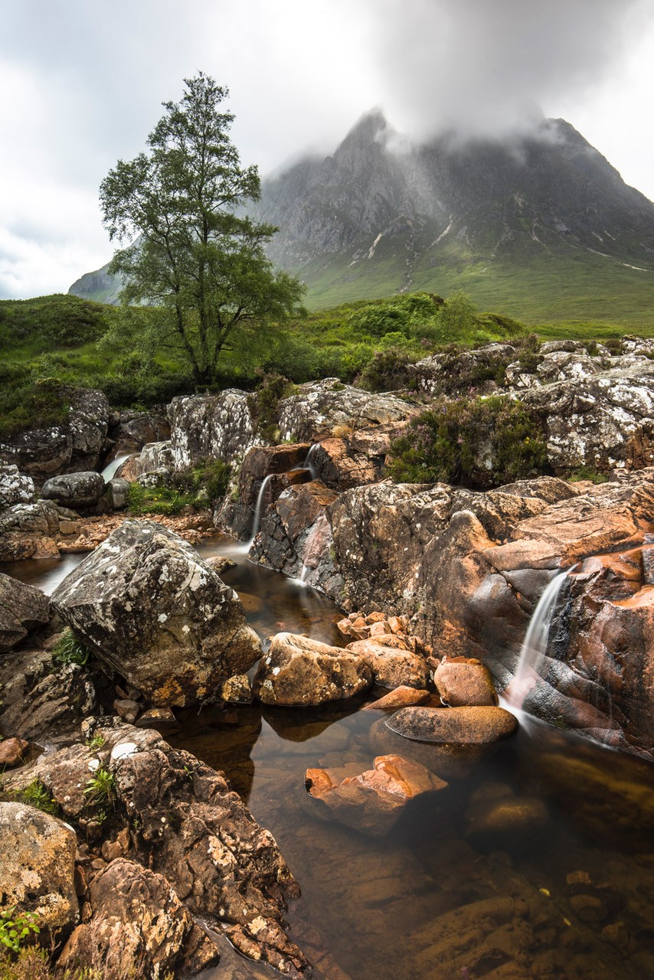
Summers trickle

Slide 27
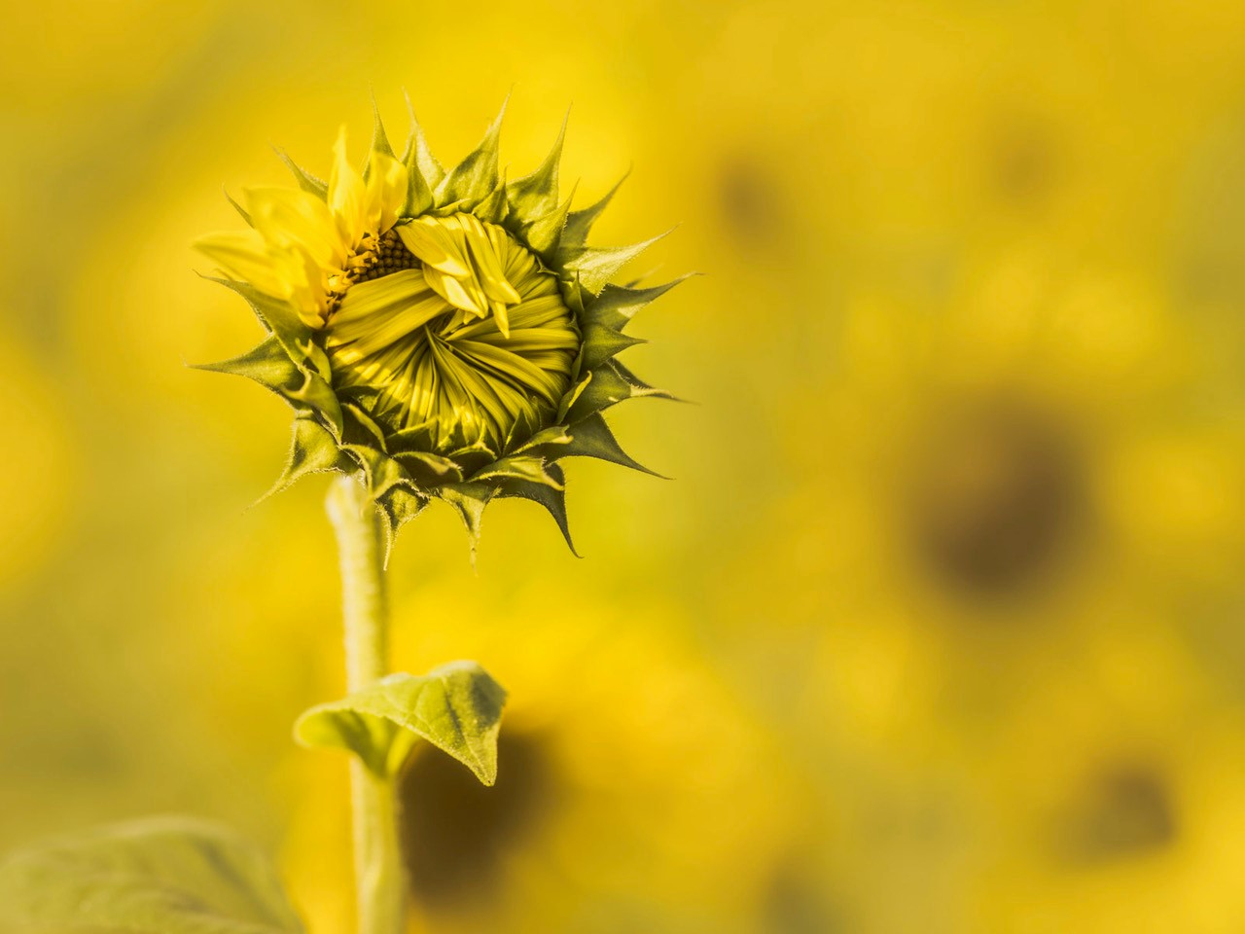
Sunflower ready to burst

Slide 28
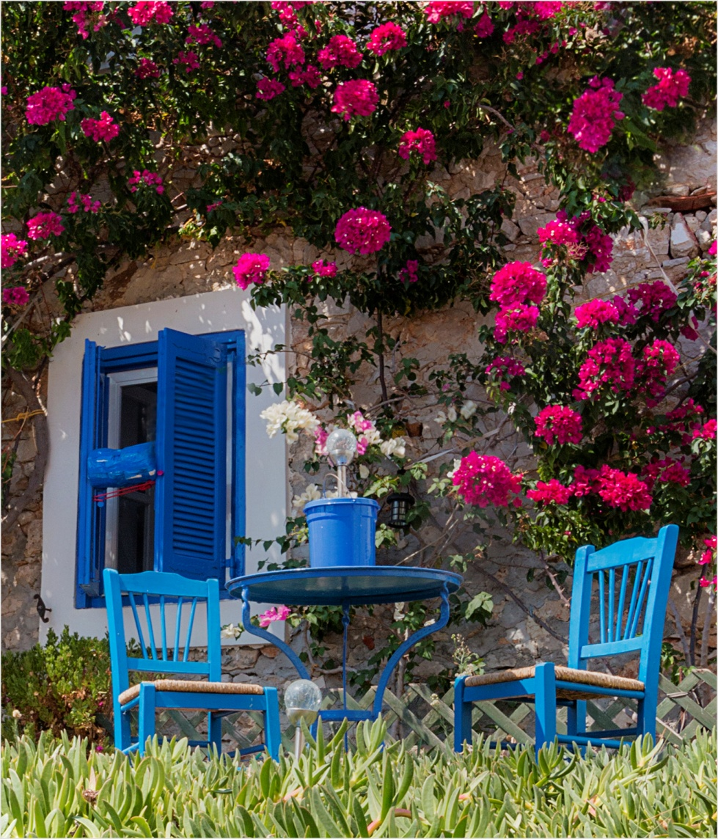
Table and Chairs

Slide 29
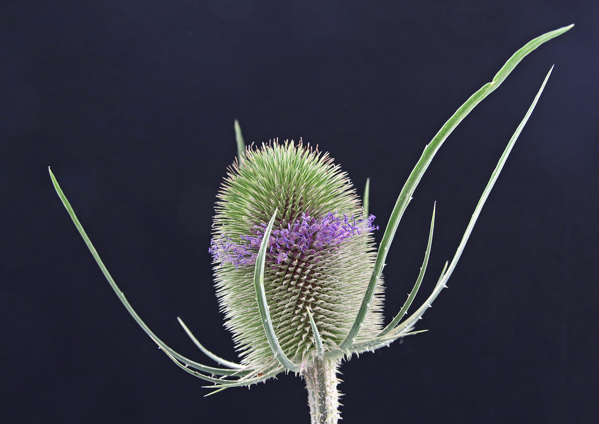
Teazle

Slide 30
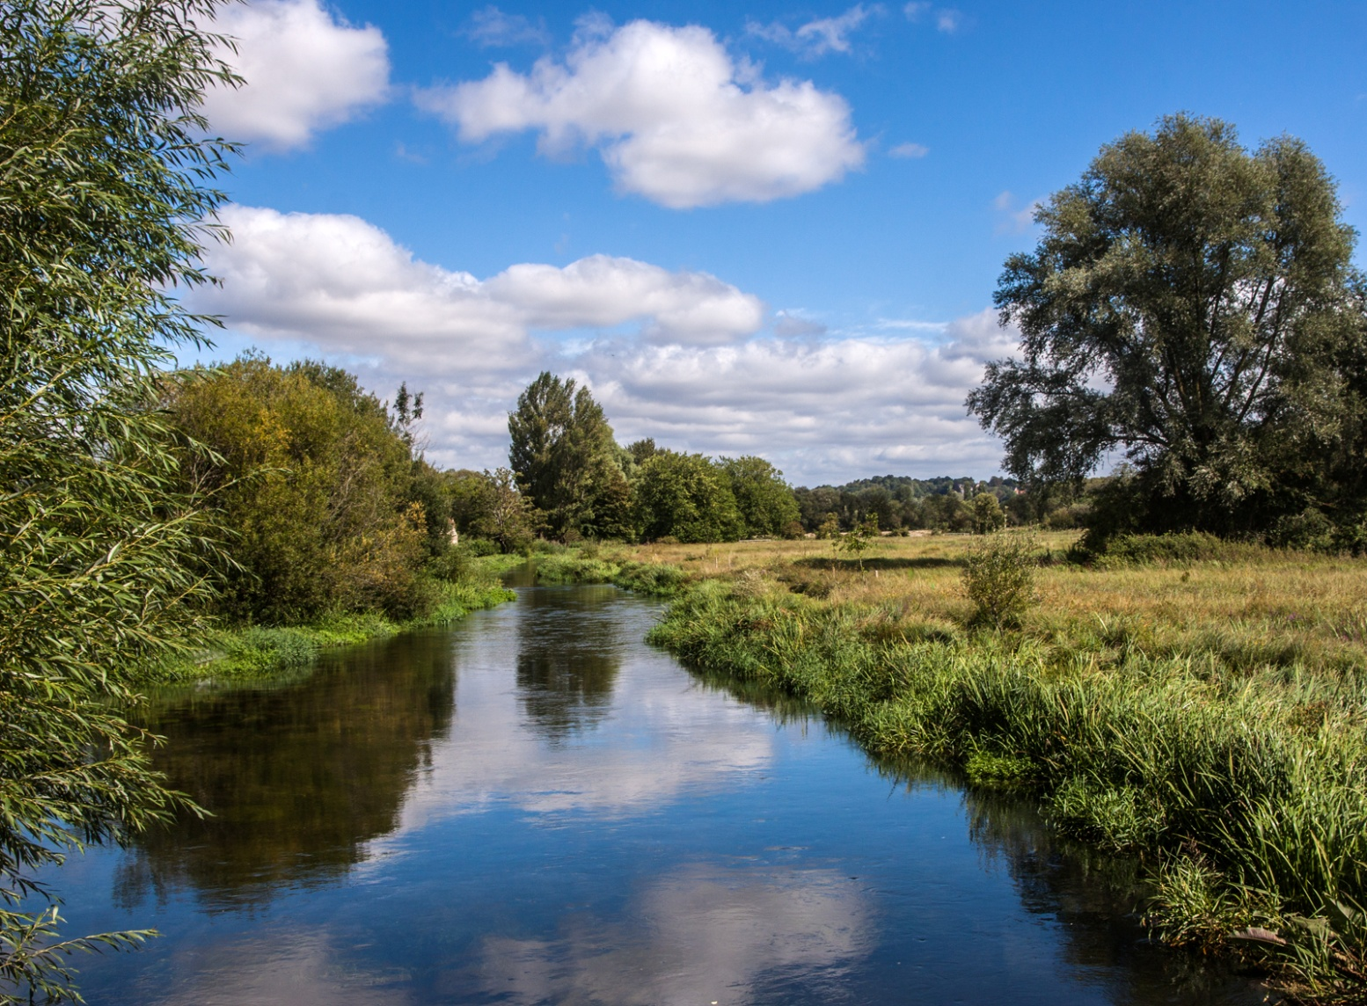
The Itchen

Slide 31
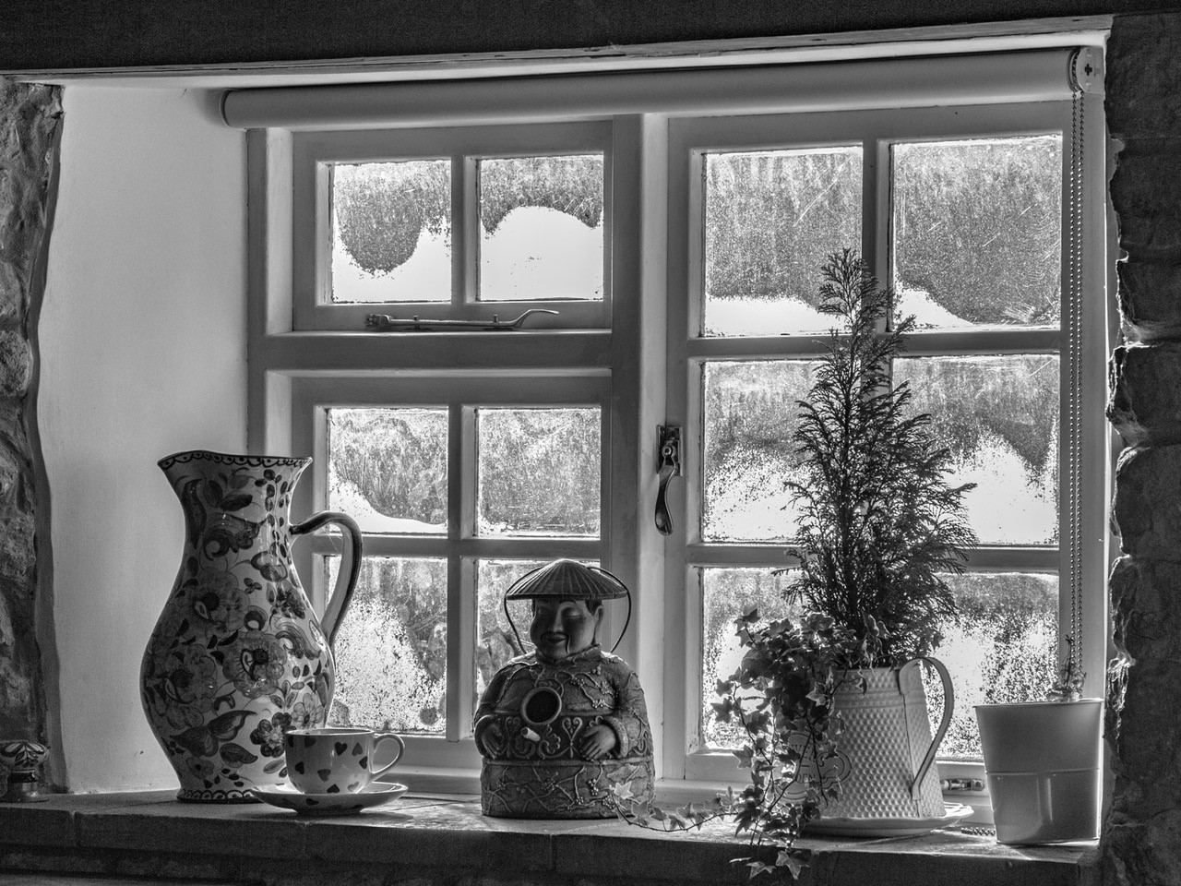
The Windowsil

Slide 32
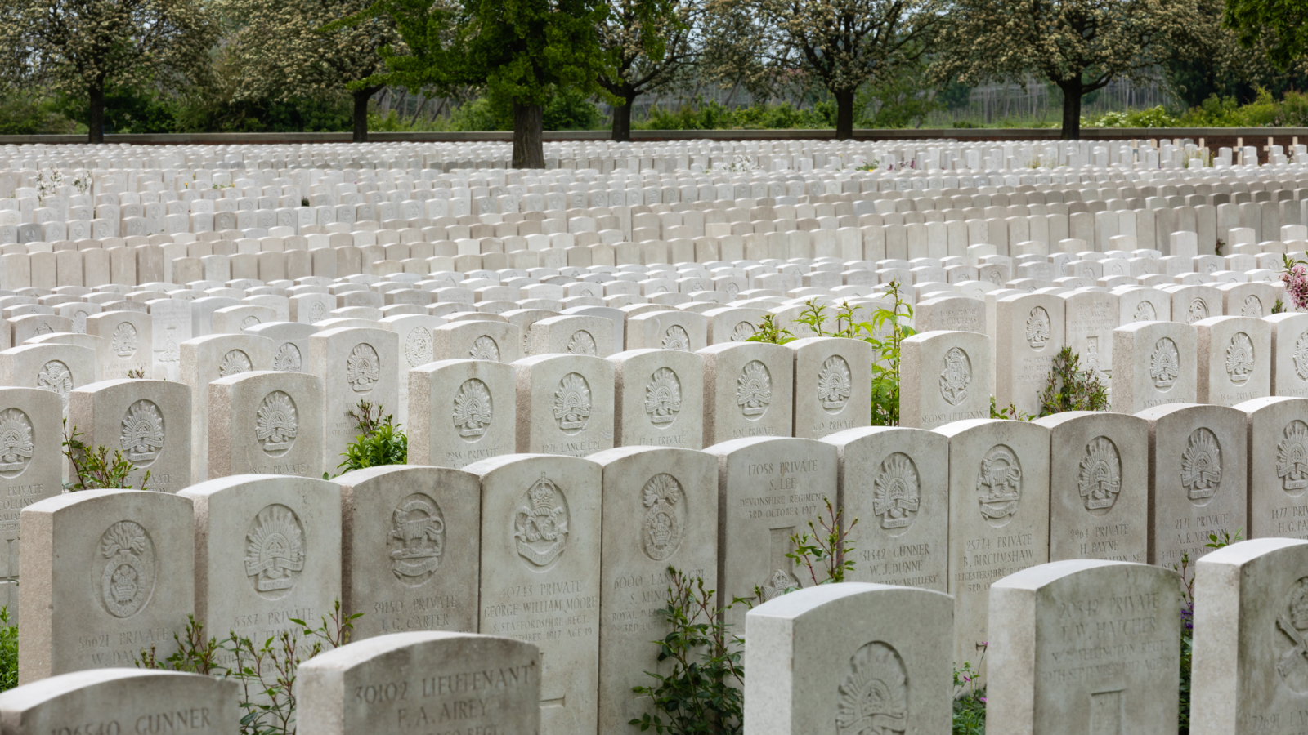
Too_many_to_count

Slide 33
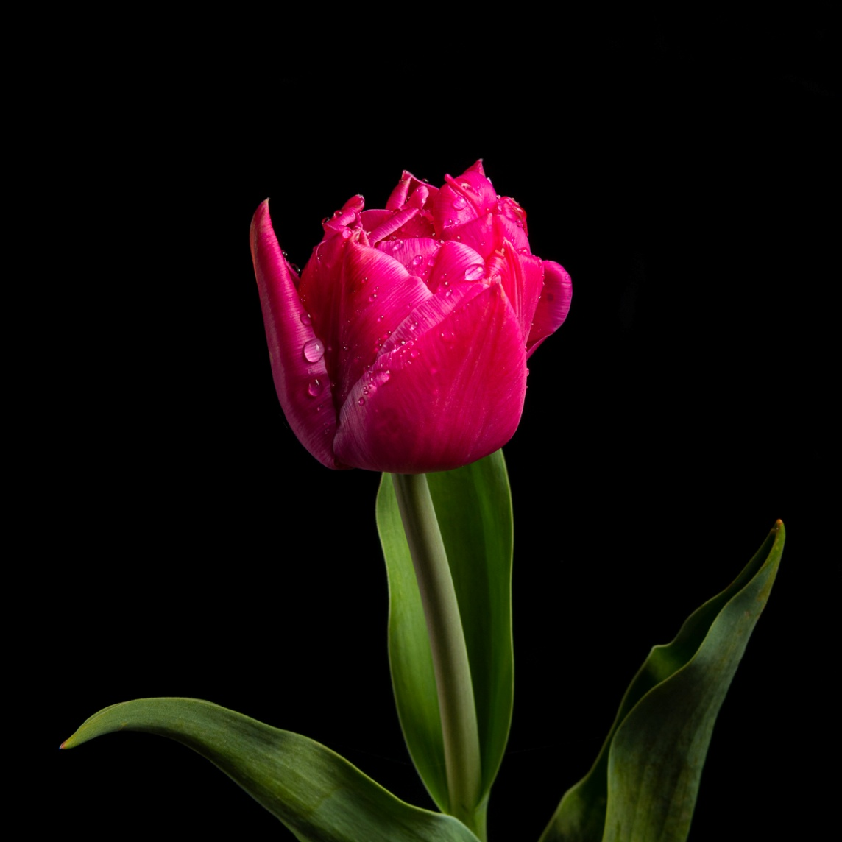
Tulip_after_rain

Slide 34
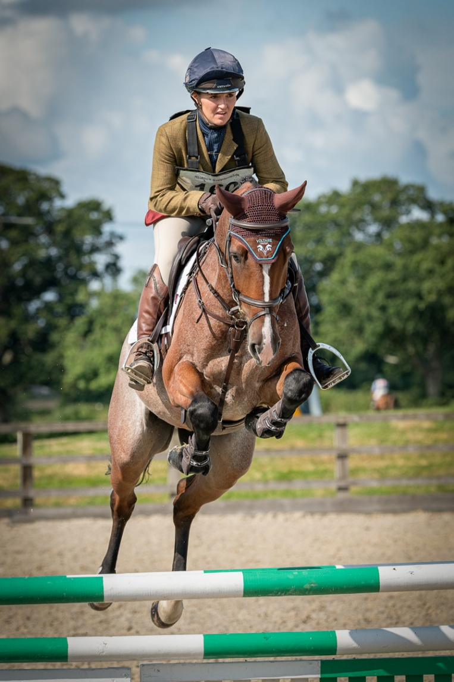
Voltaire

Slide 35
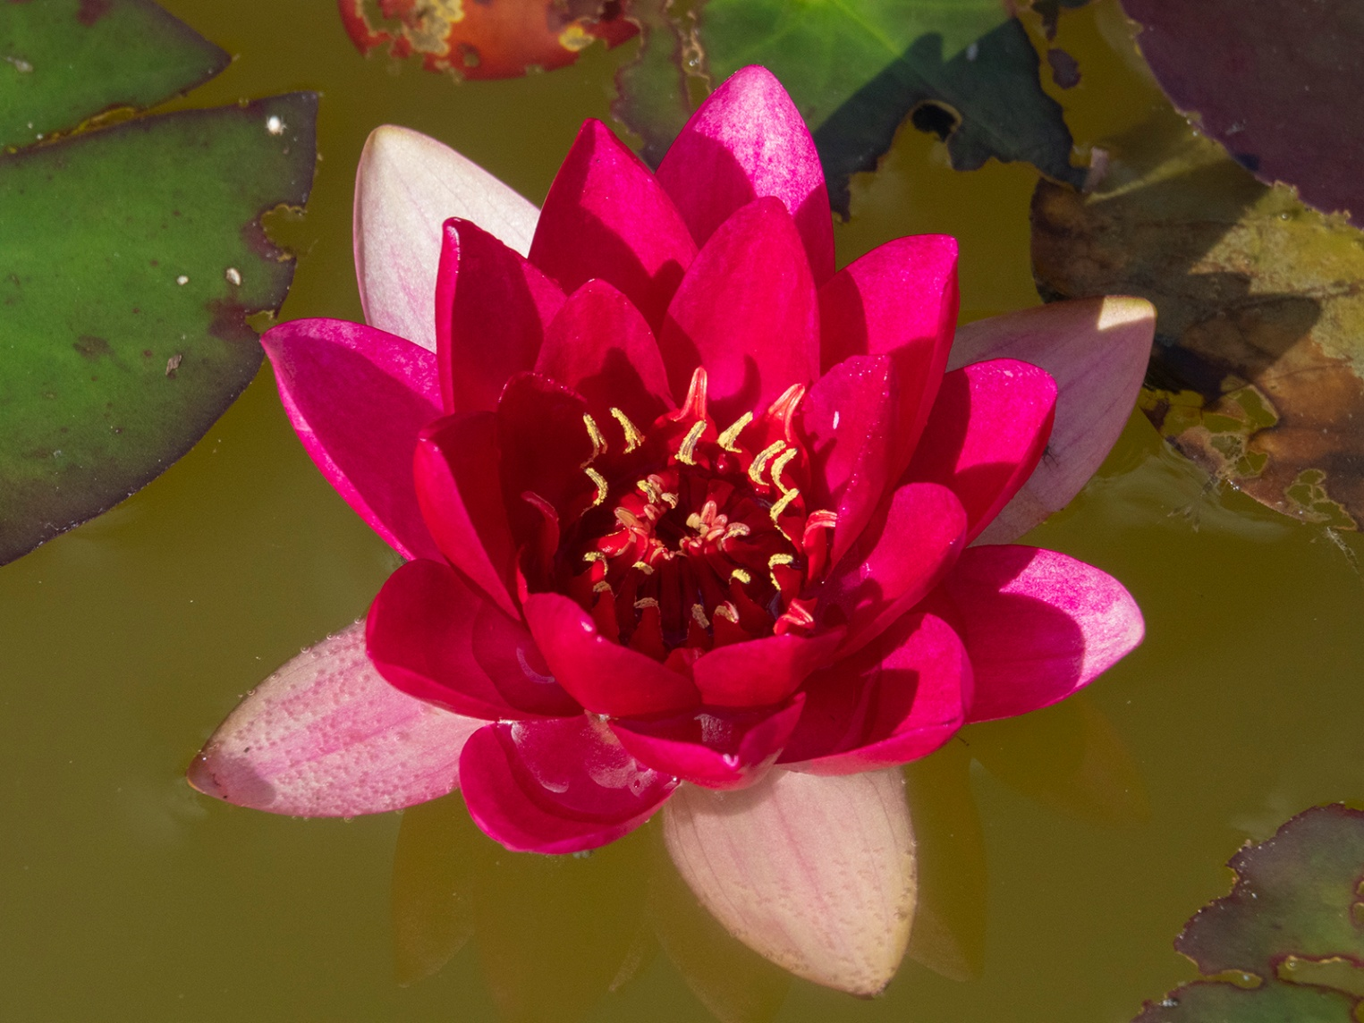
Water Lilly

Slide 36
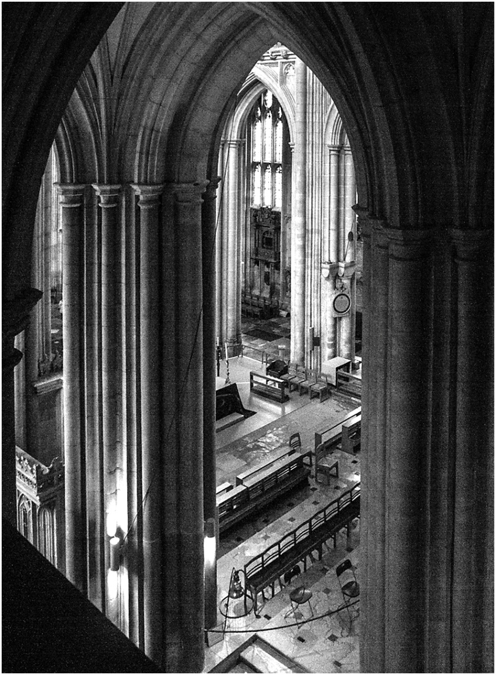
Winchester Cathedral

